Slide 1
SWPPP TRAINING
Akron-Canton Airport
September 2021
Speakers – Tim Arendt and Mark Ervin of Gresham Smith

Slide 2
Today’s Agenda
1. SWPPP Training – All Attendees
Training Presentation (25 minutes)

Slide 3
STORMWATER POLLUTION PREVENTION PLAN

Slide 4
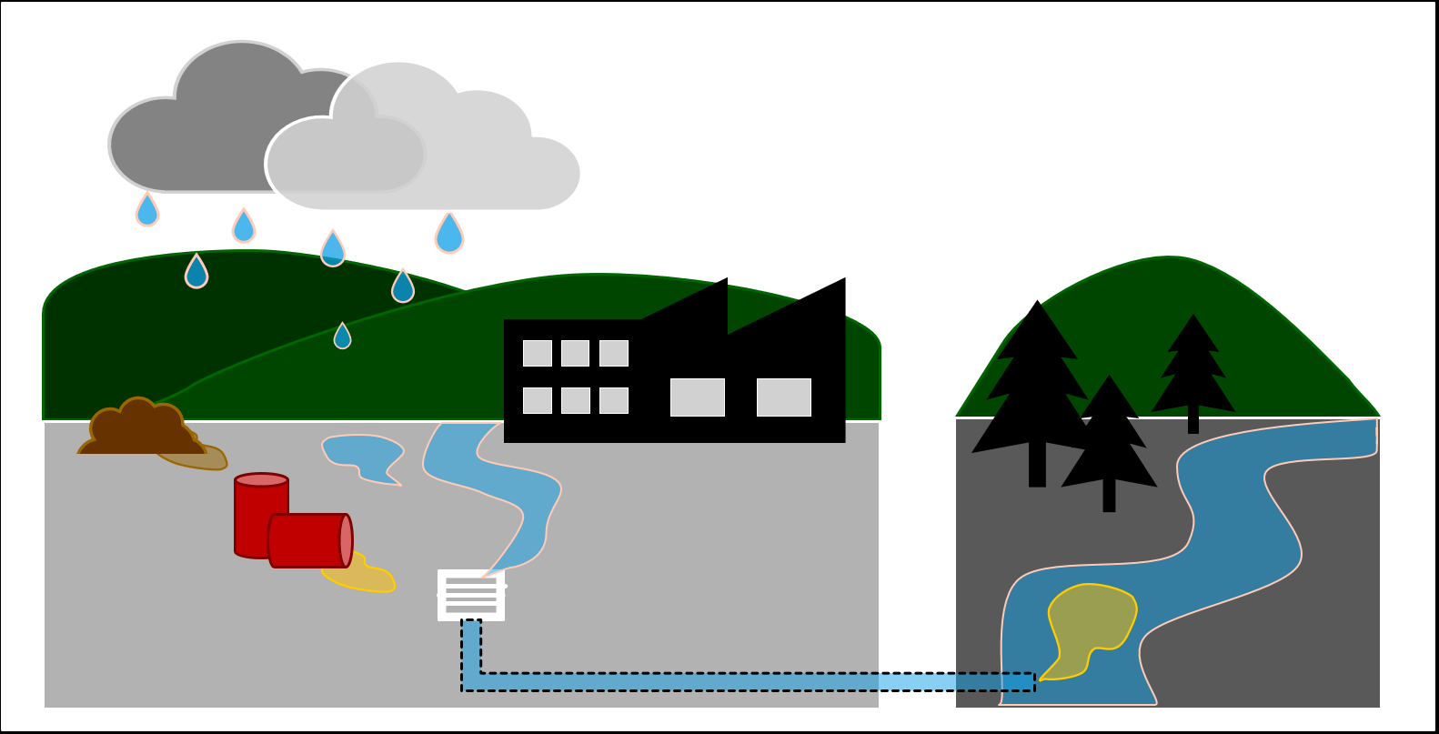
Materials used in airport or tenant “industrial activities” and exposed to stormwater can pollute streams without control measures.
Stormwater Pollution Prevention Plan is a tool required by Ohio EPA to prevent contamination of the surface waters.
Sediment
Deicing
Vehicle Washing
Material Handling
Fueling
Industrial Activities

Slide 5
Storm Water Pollution Prevention Plan (SWPPP)
Stormwater
Rainfall, melting ice, and melting snow that:
Infiltrates through pervious surfaces (soils, gravel, swales) or
Runs off over impervious surfaces (concrete, asphalt, rooftops, compacted soil)
Flows through sewers, ditches as a point source to surface waters
Pollution
Substance introduced to stormwater with potential for violating surface water quality standards.
Pollution Prevention
Environmentally sound and cost-effective way to control potential contamination near source.

Slide 6
SWPPP Applicability and Purpose
SWPPP for Overall Airport and
Tenant Lease Areas
Identifies stormwater pollutants and pollutant generating activities
Establishes pollutant control measures
Defines inspections and documentation

Slide 7
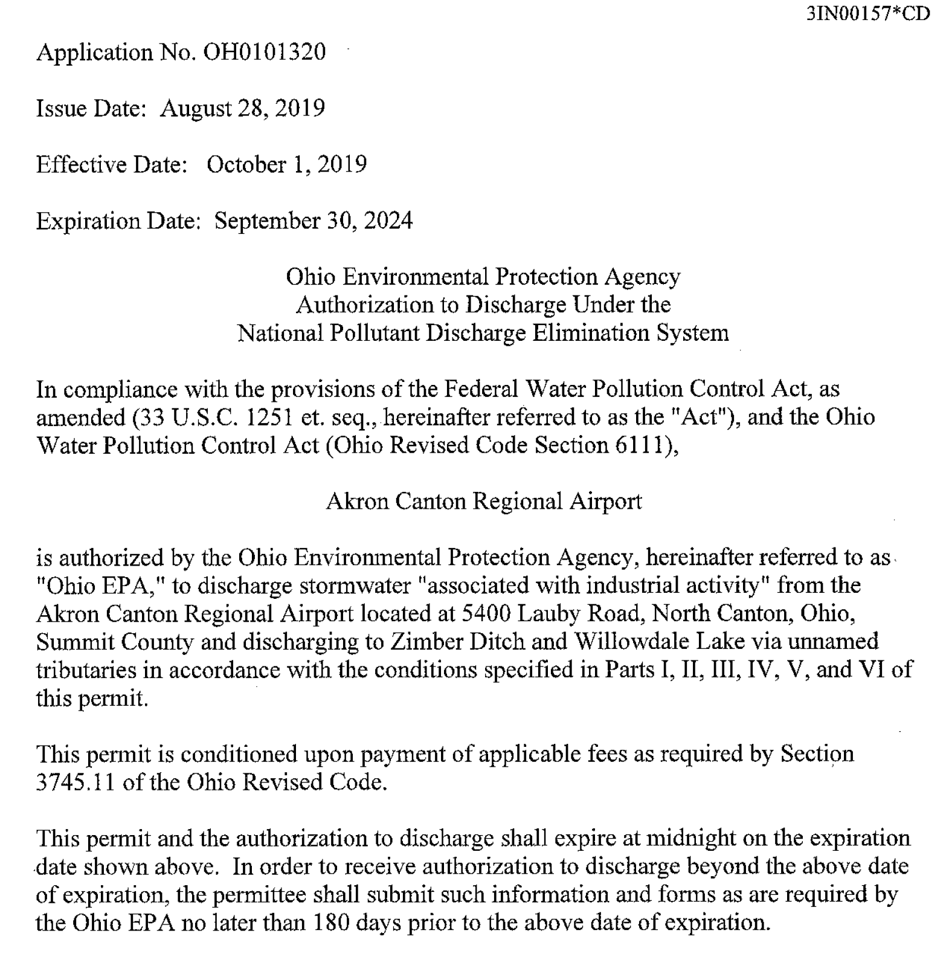
CAK NPDES Permit
Permit includes:
Authorized stormwater outfalls
Pollutant discharge limits
Stormwater sampling/reporting requirements
SWPPP requirements

Slide 8
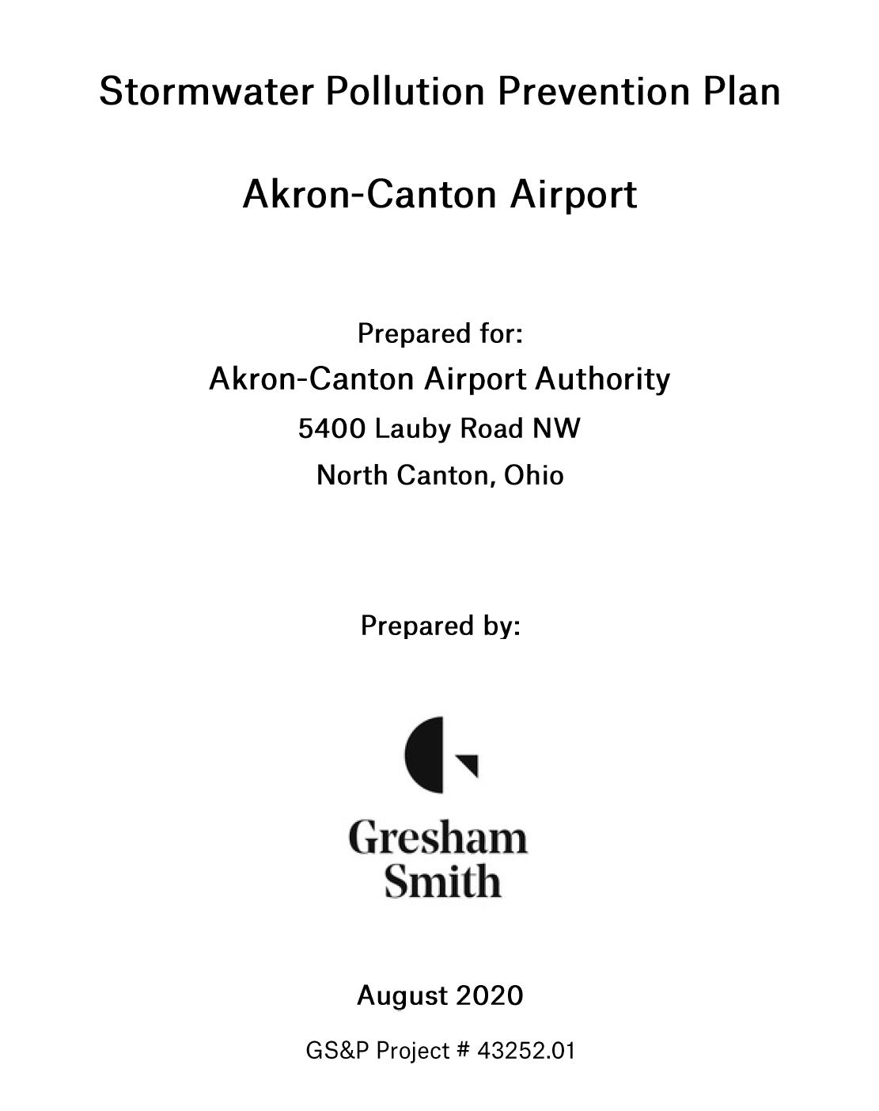
CAK SWPPP
Key components:
Pollution Prevention Team
Facility Drainage Map
Potential Pollutant Sources
Pollutant Control Measures
Monitoring and Inspections
Employee Training
Recordkeeping

Slide 9
CAK SWPPP
Key components:
Pollution Prevention Team
Facility Drainage Map
Potential Pollutant Sources
Pollutant Control Measures
Monitoring and Inspections
Employee Training
Recordkeeping

Slide 10
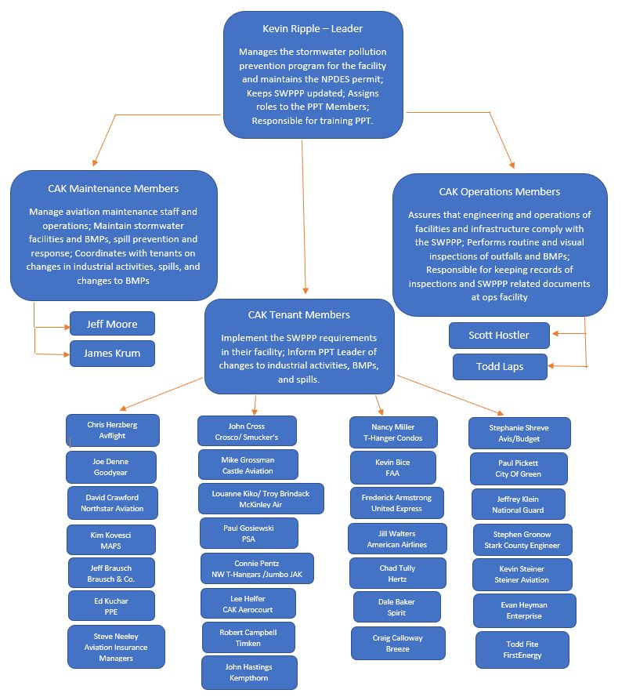
1. CAK Pollution Prevention Team

Slide 11
1. CAK Pollution Prevention Team Roles and Responsibilities
PPT Leader (CAK)
Assign team roles
CAK Tenant Team Members
Understand SWPPP/share with staff
Coordinate with your other plans
Manage pollution prevention at your facility
Implement control measures
Assist with inspections
Address spills or emergencies
Report issues to CAK PPT leader
Provide guidance to your staff
Coordinate inspections, reporting, training
Update SWPPP when changes
Correspond with regulators
Lead resolution of identified issues
Coordinate with other plans

Slide 12
1. CAK Pollution Prevention Team Roles and Responsibilities
CAK Maintenance Team Members
CAK Operations Team Members
Read SWPPP
Provide maintenance of controls
Coordinate with CAK PPT Leader on maintenance issues and status
Address maintenance issues with pollutant generating activities
Understand location and function of structural control measures
Provide guidance to team members
Understand pollutants and pollutant generating activities
Understand location and function of structural control measures
Document observations and collected data per SWPPP forms
Address operational performance issues with controls
Understand polluting activities
Read SWPPP
Provide routine inspections

Slide 13
CAK SWPPP
Key components:
Pollution Prevention Team
Facility Drainage Map
Potential Pollutant Sources
Pollutant Control Measures
Monitoring and Inspections
Employee Training
Recordkeeping

Slide 14
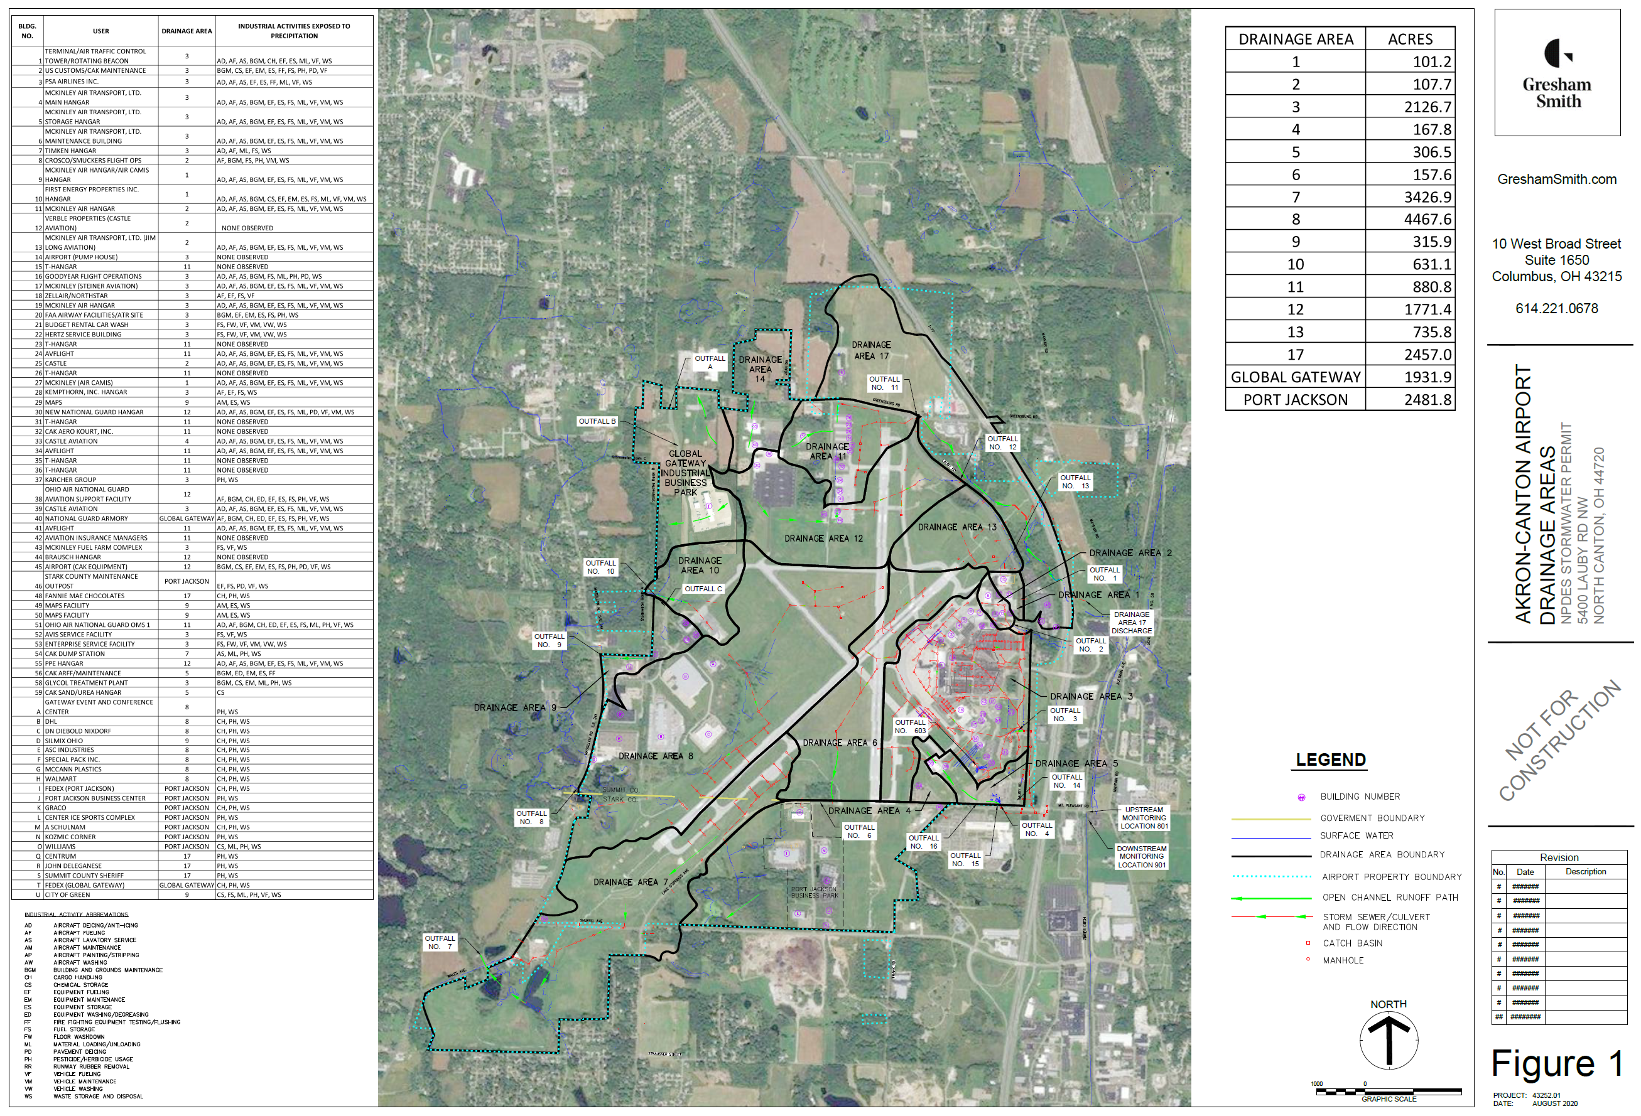
2. Facility
Drainage Map

Slide 15
CAK SWPPP
Key components:
Pollution Prevention Team
Facility Drainage Map
Potential Pollutant Sources
Pollutant Control Measures
Monitoring and Inspections
Employee Training
Recordkeeping

Slide 16
3. Potential Pollutant Sources
Vehicle/Aircraft Fueling
Vehicle/Aircraft Maintenance
Material Handling and Storage
Vehicle/Aircraft Washing
Sediment from Construction
Aircraft/Runway Deicing

Slide 17
3. Potential Pollutant Sources – Non-Stormwater Discharges
Discharges defined as “non-stormwater” are prohibited, except:
Fire hydrant flushings
Potable water, including water line flushings
Air conditioning condensate
Irrigation water IF pesticides and herbicides have been applied per instruction
Pavement or building washwater IF no detergents are used and it contains no sediment, debris or oil.

Slide 18
CAK SWPPP
Key components:
Pollution Prevention Team
Facility Drainage Map
Potential Pollutant Sources
Pollutant Control Measures
Monitoring and Inspections
Employee Training
Recordkeeping

Slide 19
4. Pollutant Control Measures / Best Management Practices
Best Management Practices (BMPs)
Measures to control to the generation and extent of pollutants in stormwater
Types:
Source Reduction Measures: Steps to reduce amount of pollutants
Example: Blending of higher amounts of water with Type 1 deicer
Operational Controls: Procedures to minimize extent pollutant contaminant stormwater
Example: Use of absorbent materials to pick up fuel spills
Structure Controls: Physical devices to remove pollutants from stormwater
Example: Sand filters for removal of sediment

Slide 20
4. Pollutant Control Measures / Best Management Practices
General Practices
Avoid exposure to stormwater
Designate areas for activities
Maintain areas in an orderly manner
Use dry cleaning techniques when possible (dry sweep)
No sweeping or washing into storm drains
Collected and dispose of washwater or discharge to the sanitary sewer

Slide 21
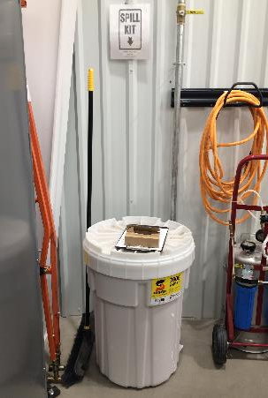
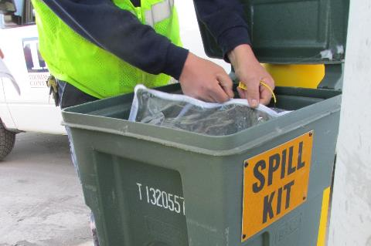
4. Pollutant Control Measures / Best Management Practices
Spill Management
Maintain spill response materials in sensitive areas
Inspect and replenish spill kits

Slide 22
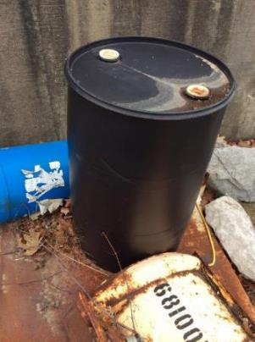
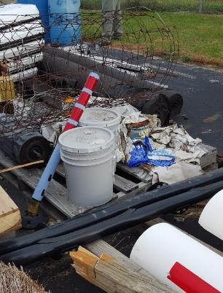
4. Pollutant Control Measures / Best Management Practices
Routine Observations
Unlabeled Drum Materials Exposed to Stormwater

Slide 23
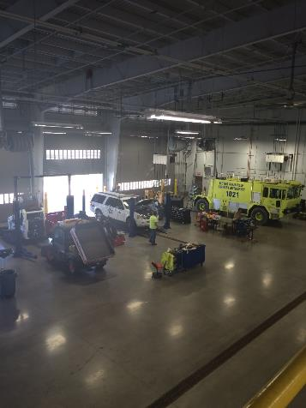
4. Pollutant Control Measures / Best Management Practices
Aircraft / Vehicle Maintenance
Perform maintenance activities in designated areas
Use drip pans or tarps to capture drips or leaks
Drain all parts of fluids prior to disposal
Maintain an organized inventory of materials
Prevent apron or hangar floor wash water from entering storm drains
Use dry cleanup methods

Slide 24
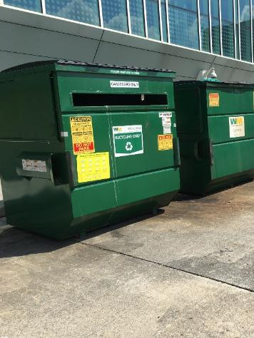
4. Pollutant Control Measures / Best Management Practices
Waste Management
Keep containers/dumpsters closed
Store away from storm water conveyances
Provide liquid or hazardous wastes with secondary containment
Scrap metal and old equipment must be clean before storing outside

Slide 25
4. Pollutant Control Measures / Best Management Practices
Deicing
Aircraft deicing only at South Deicing Pad
North Pad could be used but not typical
Can apply limited deicer to critical aircraft surfaces at gates for safe aircraft taxi to pads (typically engine cowlings).
No wing, rear stabilizer, fuselage deicing
Urea deicer application to pavement limited to emergency use
Deicer treatment system
Be aware of what it is not designed to treat (oils, fuels, paint)

Slide 26
CAK SWPPP
Key components:
Pollution Prevention Team
Facility Drainage Map
Potential Pollutant Sources
Pollutant Control Measures
Monitoring and Inspections
Employee Training
Recordkeeping

Slide 27
5. Monitoring and Inspections
ROUTINE INSPECTIONS
Focus on areas with industrial activities
Pollutant generating activities
BMPs / controls
Discharges
Frequency at discretion of PPT leader – quarterly suggested
MONTHLY DEICING SEASON
Focus on areas where deicing occurs, deicer controls/treatment
Outfalls discharging flows from pavement/aircraft deicing areas
Observe stormwater for typical deicing features
Odors
Coloration (orange/green/black)
Biofilm / slime
QUARTERLY – ALL OUTFALLS
Visual assessment of water
Align with NPDES sampling where applicable
Observe stormwater for:
Odors
Coloration
Clarity
Solids
Sheen
Foam
Formal inspections and documentation performed by CAK Operations / Environmental Staff
Tenants must routinely inspect their own pollutant generating activities

Slide 28
CAK SWPPP
Key components:
Pollution Prevention Team
Facility Drainage Map
Potential Pollutant Sources
Pollutant Control Measures
Monitoring and Inspections
Employee Training
Recordkeeping

Slide 29
6. Employee Training
Yearly training (this session) required for CAK and tenant pollution prevention team members
PPT members should make recorded training sessions available to staff engaging in pollutant generating, control measure operations, and controls maintenance activities
Record attendance in SWPPP documentation

Slide 30
CAK SWPPP
Key components:
Pollution Prevention Team
Facility Drainage Map
Potential Pollutant Sources
Pollutant Control Measures
Monitoring and Inspections
Employee Training
Recordkeeping

Slide 31
7. Recordkeeping
Forms found in SWPPP Appendix
Spill Log (location, date, material spilled, amount, environmental impacts, mitigation measures taken)
Routine (Quarterly) Inspection of Activities and Controls
Quarterly Visual Inspection Form for Outfalls
Training Attendance
Annual NPDES Report

